Slide 1
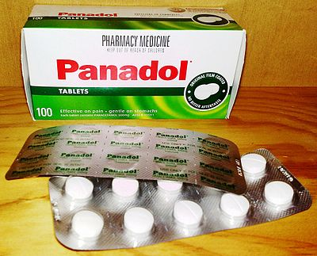
1mg Tablet
Presented by
Krishna Verma cds01_006

Slide 2
Acknowledgement
How to scrap data
How to clean data
conclusion
Thankyou

Slide 3

How to scrap data from website:https://www.1mg.com/categories/homeopath
First, I would like to download all the libraries that are helpful for web scraping.“
selenium
pandas
time
html_to_json
No Such Element Exception
tqdm

Slide 4
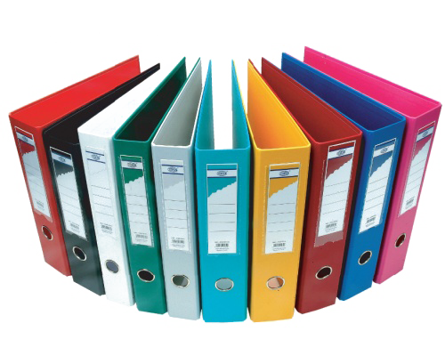
Process
When my all data scraped which is usefull for my project ,
Then I divided the Date Two Table converted By CSV file which Name are_
First table
Second Table
After all those Things I merge Both Table and find The Duplicate values and null values by using Pandas .
After Clean the Merge Data ,I stored all data in Csv file which name is finale .

Slide 5
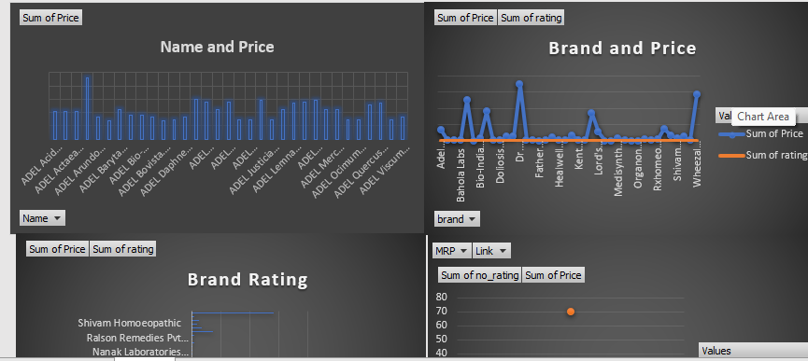
Conclusion
After ,All those things Utilize Excel I Created a Dasboard, Which name is 1mg tablet.
This is all about my project.

Slide 6

Thank you

